Slide 1
Shoulder Biomechanics
Dr Sarath Babu V
Professor cum Principal
Dept. of Sports Physiotherapy
MGM Institute Of Physiotherapy
Chh. Sambhajinagar

Slide 2
The shoulder complex, composed of the clavicle, scapula, and humerus, is an intricately designed combination of three joints that links the upper extremity to the thorax.
Shoulder complex
acromioclavicular (AC) joint
glenohumeral (GH) joint
sternoclavicular (SC) joint
scapulothoracic (ST) joint

Slide 3
The articular structures of the shoulder complex are designed primarily for mobility, allowing us to move and position the hand through a wide range of space.
The glenohumeral (GH) joint, which links the humerus and scapula, has greater mobility than any other joint in the body.

Slide 4
They are connected to the axial skeleton by a single joint, the sternoclavicular (SC) joint.
The articulation between the scapula and the thorax is often described as the scapulothoracic (ST) joint

Slide 5
The joints that compose the shoulder complex can, in combination with trunk motion, contribute as much as 180˚ of elevation to the upper extremity.
Elevation of the upper extremity refers to the combination of scapular, clavicular, and humeral motion that occurs when the arm is raised either forward or to the side (including sagittal plane flexion, frontal plane abduction, and all the motions in between).

Slide 6
1. Sternoclavicular Joint
The sternoclavicular joint serves as the only structural attachment of the shoulder complex and upper extremity to the axial skeleton.
The sternoclavicular joint is a plane synovial joint with three rotary and three translatory degrees of freedom. The joint has a synovial capsule, a joint disc, and three major ligaments.

Slide 7
Rotations at the sternoclavicular joint produce movement of both the clavicle and the scapula under conditions of normal function, because the scapula is linked with the lateral end of the clavicle at the acromioclavicular joint.
Similarly, movement of the scapula often results in movement of the clavicle at the sternoclavicular joint.

Slide 8
Articulating surfaces
Consists of 2 saddle shaped surfaces,one at the sternal end of the clavicle & one at the notch formed by the manubrium of the sternum & the first costal cartilage
Articular connective tissue
joint capsule
Sternoclavicular Disc
major ligaments

Slide 9
Sternoclavicular Joint Capsule and Ligaments
The sternoclavicular joint is surrounded by a fairly strong fibrous capsule but depends on three ligament complexes for the majority of its support: the anterior and posterior sternoclavicular ligaments, the bilaminar costoclavicular ligament, and the interclavicular ligament

Slide 10
Sternoclavicular Disc
fibrocartilage disc, or meniscus, that increases congruence between the articulating surfaces.

Slide 11
During elevation and depression of the clavicle, the medial articular surface rolls and slides on the relatively stationary disc, with the upper attachment of the disc serving as a pivot point.
During protraction and retraction of the clavicle, the sternoclavicular disc and medial articular surface roll and slide together on the manubrial facet, with the lower attachment of the disc serving as a pivot point.

Slide 12
provides stability by increasing joint congruence and by absorbing forces transmitted along the clavicle from its lateral end to the sternoclavicular joint.

Slide 13
Has 2 lamina-Anterior lamina & Posterior lamina
Limits extremes of all clavicular motions except depression
3. Interclavicular ligament
Spans over the jugular notch
Checks excessive depression
Protects the structures like Brachial plexus & subclavian artery.

Slide 14
Sternoclavicular joint ligaments :
1. Sternoclavicular ligament
Anterior & posterior
Check ant & post movement of head of clavicle
2. Costoclavicular ligament
Strong ligament
Extends from cartilage of first rib to costal tuberosity on inferior surface of clavicle

Slide 15
Kinematics/SC joint motion
Elevation – depression
It occurs around A-P axis
Arthrokinematically,
Elevation – (0-45deg) upwards rolling & inferior slide of convex head of clavicle on concave manubrial facet of sternum
Depression – (0-15deg) inferior rolling & superior slide of clavicular head

Slide 16
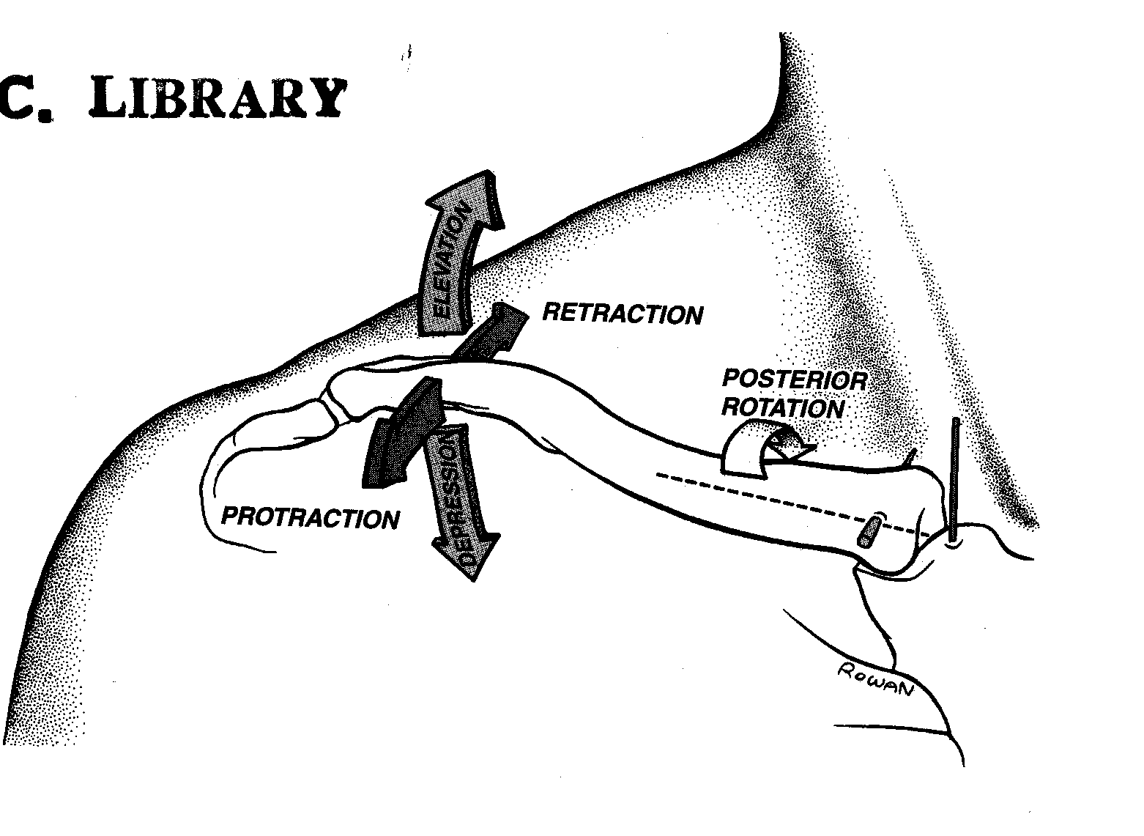

Slide 17
Movement takes place bet medial end of Clavicle
& articular disk
So disk is a part of manubrium during this movt
Protraction – Retraction
It occurs around Vertical axis
Range 0-15 deg each

Slide 18
Protraction – anterior rolling & sliding of concave articular surface of clavicle on convex surface of manubrium
Retraction – same arthrokinematics in opposite direction
Movment takes place bet articular disk & manubrium

Slide 19
Anterior – Posterior rotation
Range – 30-55 deg
Occurs as a spin between saddle shaped surfaces of the clavicle & manubriocostal facet
Posterior rotation from neutral

Slide 20
Sternoclavicular Stress
Degenerative change
Dislocations of the sternoclavicular joint represent only 1% of joint dislocations in the body and only 3% of shoulder girdle dislocations.

Slide 21
Acromioclavicular Joint
The acromioclavicular joint attaches the scapula to the clavicle.
It is generally described as a plane synovial joint with
three rotational and three translational degrees of freedom.
It has a joint capsule, two major ligaments, and a joint disc that may or may not be present.

Slide 22
The primary function of
allow the scapula to rotate in three dimensions during arm movement so that upper extremity motion is increased,
the glenoid is positioned beneath the humeral head, and the scapula remains congruent and stable on the thorax.
The acromioclavicular joint also allows transmission of forces from the upper extremity to the clavicle.

Slide 23
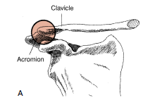
Acromioclavicular Articulating Surfaces
The acromioclavicular joint consists of the articulation between the lateral end of the clavicle and a small facet on the acromion of the scapula

Slide 24
The articular facets are considered to be incongruent and vary in configuration. They may be flat, reciprocally concave-convex, or reversed (reciprocally convex-concave).

Slide 25
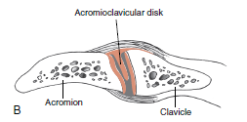
Acromioclavicular Joint Disc
The disc of the acromioclavicular joint may vary in size between individuals, within an individual as they age, and between shoulders of the same individual.

Slide 26
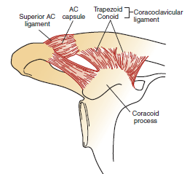
Acromioclavicular Capsule
Superior acromioclavicular ligaments
Inferior acromioclavicular ligaments
Coracoclavicular ligaments

Slide 27
Acromioclavicular Capsule and Ligaments
The capsule of the acromioclavicular joint is weak and cannot maintain integrity of the joint without the reinforcement of the superior and inferior acromioclavicular ligaments and the coracoclavicular ligaments

Slide 28
The acromioclavicular ligaments assist the capsule in apposing the articular surfaces while the superior acromioclavicular is the main ligament limiting movement caused by anterior forces applied to the distal clavicle.
The fibers of the superior acromioclavicular ligament are reinforced by aponeurotic fibers of the trapezius and deltoid muscles, making the superior joint support stronger than the inferior.

Slide 29
The coracoclavicular ligament, although not belonging directly to the anatomic structure of the AC joint, firmly unites the clavicle and scapula and provides much of the joint’s superior and inferior stability.
This ligament is divided into a medial portion, the conoid ligament, and a lateral portion, the trapezoid ligament.
The conoid ligament, medial and slightly posterior to the trapezoid, is more triangular and vertically oriented.
The trapezoid ligament is quadrilateral in shape and is nearly horizontal in orientation.

Slide 30
The conoid portion of the coracoclavicular ligament provides the primary restraint to translatory motion caused by superior-directed forces applied to the distal clavicle
The trapezoid portion of the coracoclavicular ligament provides more restraint than the conoid portion to translatory motion caused by posterior-directed forces applied to the distal Clavicle
Both portions of the coracoclavicular ligament limit upward rotation of the scapula at the acromioclavicular joint.

Slide 31
Acromioclavicular Motions
The primary rotary motions that take place at the AC joint are
Internal/external rotation,
Anterior/posterior tilting or tipping,
Upward/downward rotation.

Slide 32
Internal/External rotation
Internal/External rotation of the scapula in relation to the clavicle occurs around an essentially vertical axis
The orientation of the glenoid fossa is important for maintaining congruency with the humeral head; maximizing the function of glenohumeral muscles, capsule, and ligaments; maximizing the stability of the glenohumeral joint; and maximizing available motion of the arm.
30° for combined internal and external ROM

Slide 33
Anterior/ Posterior tilting
Anterior/ Posterior tilting occurs around an oblique “coronal” axis(20º, although up to 40° or more may be possible in the full range from maximum flexion to extension.)
Anterior tilting results in the acromion tilting forward and the inferior angle tilting backward .
Posterior tilting rotates the acromion backward and the inferior angle forward.

Slide 34
Elevation of the scapula on the thorax, such as occurs with a shoulder shrug, can result in anterior tilting.
During normal flexion or abduction of the arm, the scapula posteriorly tilts on the thorax as the scapula is upwardly rotating.

Slide 35
Upward/Downward Rotation
Upward/Downward rotation around an oblique “A-P” axis
Upward rotation tilts the glenoid fossa upward , and downward rotation is the opposite motion.
30˚ of available passive ROM into upward/ downward rotation

Slide 36
Acromioclavicular Stress
trauma and degenerative changes.
Trauma in contact sports or a fall on the shoulder with the arm adducted.

Slide 37
Scapulothoracic Joint
The scapulothoracic “joint” is formed by the articulation of the scapula with the thorax. It is not a true anatomic joint because it is not a union of bony segments by fibrous, cartilaginous, or synovial tissues.

Slide 38
Any movement of the scapula on the thorax must result in movement at the AC joint, the SC joint, or both.
This makes the functional ST joint part of a true closed chain with the AC and SC joints and the thorax.

Slide 39
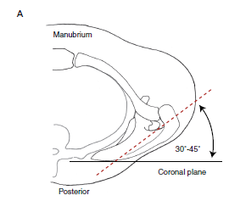
Resting Position of the Scapula
The scapula rests on the posterior thorax approximately 5 cm from the midline between the second through seventh ribs.
The scapula is internally rotated 35° to 45° from the coronal plane, is tilted anteriorly approximately 10° to 15° from vertical, and is upwardly rotated 5° to 10° from vertical.

Slide 40
This magnitude of upward rotation has as its reference a “longitudinal” axis perpendicular to the axis running from the root of the scapular spine to the acromioclavicular joint.
If the vertebral (medial) border of the scapula is used as the reference axis, the magnitude of upward rotation at rest is usually described as 2° to 3° from vertical.
Although these “normal” values for the resting scapula are cited, substantial individual variability exists in scapular rest position, even among healthy subjects.

Slide 41
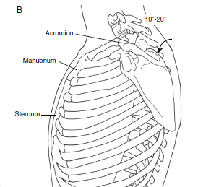
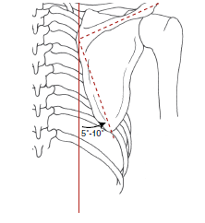

Slide 42
Motions of the Scapula
The motions of the scapula from the resting position include three rotations that have already been described because they occur at the acromioclavicular joint.
These are upward/downward rotation, internal/external rotation, and anterior/posterior tilting.

Slide 43
Of these three acromioclavicular joint rotations, only upward/downward rotation is easily observable at the scapula, and it is therefore considered for our purposes to be a “primary” scapular motion.
Internal/external rotation and anterior/posterior tilting are normally difficult to observe and are therefore considered for our purposes to be “secondary” scapular motions.

Slide 44
The scapula presumably also has available the translatory motions of scapular elevation/ depression and protraction/retraction.

Slide 45
Upward/Downward Rotation
Upward rotation of the scapula on the thorax is the principal motion of the scapula observed during active elevation of the arm and plays a significant role in increasing the arm’s range of elevation overhead.
Approximately 50° to 60° of upward rotation of the scapula on the thorax is typically available.

Slide 46
Most often, scapular upward/downward rotation results from a combination of these sterno-clavicular and acromioclavicular motions.
In describing upward and downward rotation of the scapula,use the inferior angle of the scapula as the referent,with upward and downward rotation described as movement of the inferior angle away from the vertebral column (upward rotation) or movement of the inferior angle toward the vertebral column (downward rotation).

Slide 47
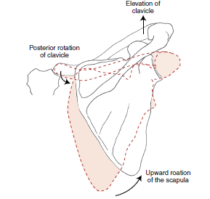

Slide 48
Because the axes of the sternoclavicular and scapulothoracic joints are not parallel, the relationships between sternoclavicular and acromioclavicular joint motions and scapulothoracic motion are more challenging to visualize.

Slide 49
Elevation/Depression
Scapular elevation and depression can be isolated (relatively speaking) by shrugging the shoulder up and depressing the shoulder downward.
Elevation and depression of the scapula on the thorax are commonly described as translatory motions in which the scapula moves upward (cephalad) or downward (caudal) along the rib cage from its resting position.

Slide 50
Scapular elevation, however, occurs through elevation of the clavicle at the sternoclavicular joint and may include subtle adjustments in anterior/posterior tilting and internal/external rotation at the acromioclavicular joint in order to keep the scapula in contact with the thorax.

Slide 51
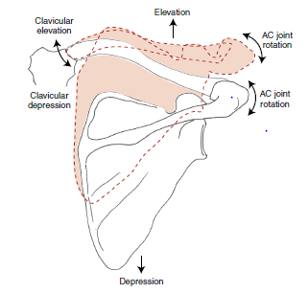

Slide 52
Protraction/Retraction
Protraction and retraction of the scapula on the thorax are often described as translatory motions of the scapula awayfrom or toward the vertebral column, respectively.
These theoretical translatory motions have also been termed scapular abduction and adduction.

Slide 53
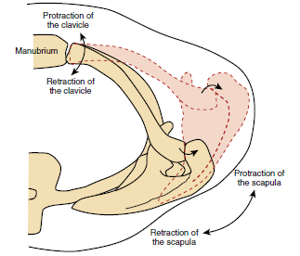

Slide 54
if protraction or abduction of the scapula on the thorax occurred as a pure translatory movement, the scapula would move directly away from the vertebral column, and the glenoid fossa would face laterally.

Slide 55
full scapular protraction results in the glenoid fossa facing anteriorly, with the scapula in contact with the rib cage.
The scapula protracts and retracts through sternoclavicular joint protraction and retraction and follows the contour of the ribs by rotating internally and externally at the acromio clavicular joint

Slide 56
Internal/External Rotation
The scapular motions of internal and external rotation are normally not overtly identifiable on physical observation but are critical to movement of the scapula along the curved rib cage.
Internal/external rotation of the scapula on the thorax should normally accompany protraction/ retraction of the clavicle at the sternoclavicular joint.

Slide 57
Anterior/Posterior Tilting
As is true for internal/external rotation, anterior/posterior tilting is normally not overtly obvious on clinical observation and yet is critical to maintaining contact of the scapula against the curvature of the rib cage.
Anterior/posterior tilting of the scapula on the thorax occurs at the acromioclavicular joint.

Slide 58
Scapulothoracic Stability
Stability of the scapula on the thorax is provided by the structures that maintain integrity of the linked acromioclavicular and sternoclavicular joints.
The muscles that attach to both the thorax and scapula maintain contact between these surfaces while producing the movements of the scapula.
In addition, stabilization is provided by the scapulothoracic musculature, which pulls or compresses the scapula to the thorax.

Slide 59
The ultimate functions of scapular motion are to orient the glenoid fossa for optimal contact with the humeral head of the maneuvering arm, to add range to elevation of the arm, and to provide a stable base for the controlled motions between the humeral head and glenoid fossa.

Slide 60
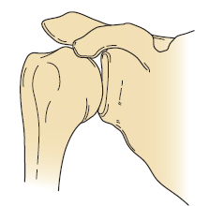
GLENOHUMERAL JOINT
Ball & socket synovial jt
3 deg of freedom
Articulating surfaces –
Proximal - Shallow concavity of glenoid fossa
Distal - Large convex head of humerus

Slide 61
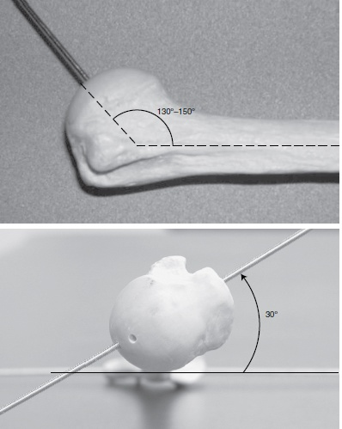
Angle of inclination -
130° to 150°
Angle of torsion - 30° posterior

Slide 62
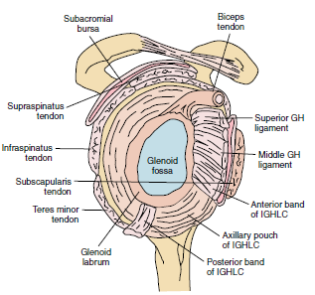
Stabilizers of gh joint
Glenoid labrum
Glenohumeral capsule
Bursae
Glenohumeral ligaments
Coracoacromial arch
Rotator cuff muscles

Slide 63
Glenoid labrum
Fibrocartilagenous ring
Enhances the depth or curvature of the fossa by approximately 50%.
Loosely attached superiorly & firmly attached inferiorly
Reduction of joint friction,and dissipation of joint contact forces.
The glenoid labrum serves as the attachment site for the glenohumeral ligaments and the tendon of the long head of the biceps brachii.

Slide 64
Glenohumeral capsule
Attaches along the rim of glenoid fossa & extends to anatomical neck
Large loose capsule that is taut superiorly & slack anteriorly & inferiorly
The capsule tightens when the humerus is abducted and laterally rotated, making this the close-packed position for the glenohumeral joint.

Slide 65
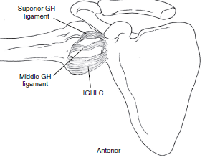
Three capsular glenohumeral ligaments (superior, middle, and inferior).

Slide 66
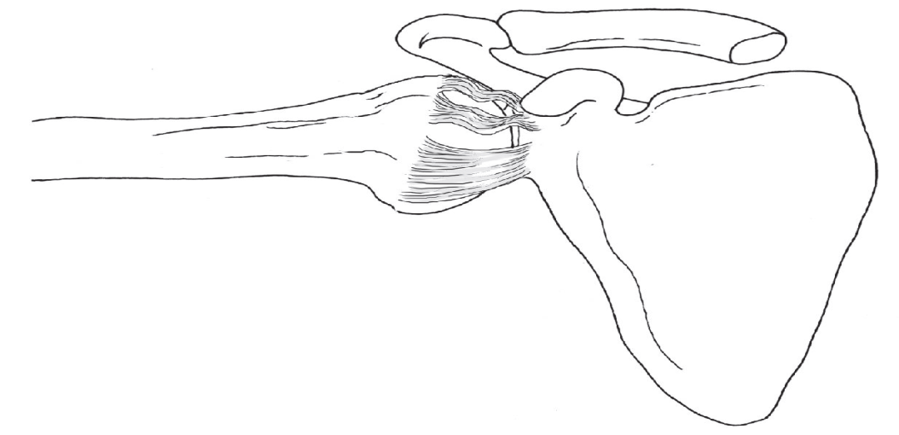
IGHLC
The inferior glenohumeral ligament is described as having three components and thus has been termed the inferior GH ligament complex (IGHLC).
The three components of the complex are the anterior and posterior ligament bands and the axillary pouch in between .
The IGHLC shows position-dependent variability in function, as well as variations in viscoelastic behavior.

Slide 67
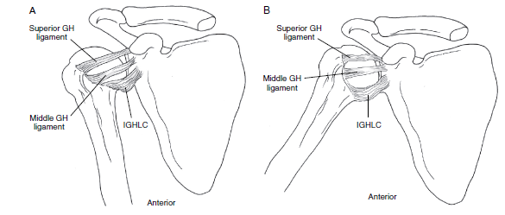

Slide 68
  Rotator interval capsule (RIC) superior GH ligament,superior capsule & coracohumeral ligament

Slide 69
The coracohumeral ligament originates from the base of the coracoid process and has two bands.
coracohumeral ligament limits inferior translation of the humeral head in the dependent arm position.
the coracohumeral ligament resists humeral lateral rotation with the arm adducted.
The ligament may also assist in preventing superior translation of the humerus, especially when the dynamic stabilizing force of the rotator cuff muscles is impaired.

Slide 70
Bursae
Subacromial & subdeltoid bursa
reflecting the presence of frictional forces between anatomical structures.
Although all bursae at the shoulder contribute to function, the most important are the subacromial and subdeltoid bursae.
These bursae separate the supraspinatus tendon and head of the humerus from the acromion, coracoid process, coracoacromial ligament, and deltoid muscle.
These bursae may be separate but are commonly continuous with each other and are collectively known as the subacromial bursa

Slide 71
Coracoacromial Arch
Also called as suprahumeral arch
Formed by the coracoid process, the acromion, the coracoacromial ligament, and the inferior surface of the acromioclavicular joint
It forms an osteoligamentous vault that covers the humeral head and forms a space within which the subacromial bursa, the supraspinatus tendon and tendon of long head of biceps lie

Slide 72
Functions –
Acts as roof of GH jt
Prevents head of humerus from dislocating superiorly
Gives protection against injury.

Slide 73
Glenohumeral osteokinematics
Flexion / extension – saggital plane
Abduction / adduction – frontal plane
Medial / lateral rotation – horizontal
COMBINE MOTION
Rotation with abduction
Abduction with Rotation

Slide 74
Glenohumeral Arthrokinematics
Flexion & Extension
Involves a spinning of humeral head about a somewhat fixed point on the face of glenoid.
Abduction & Adduction
Abduction – superior rolling & inferior sliding of head of humerus
Adduction - reverse motion

Slide 75
External & internal rotation
External rotation-humeral head simultaneously rolls posteriorly & slides anteriorly on the glenoid fossa
Internal rotation – Reverse motion

Slide 76
Static stabilization of GH joint
Inclined plane of glenoid
Superior capsular structures / rotater interval capsule
Scapulothoracic posture
Negative intraarticular pressure in GH joint

Slide 77
DYNAMIC STABILIZATION OF GH JOINT
Deltoid & glenohumeral stabilization
Rotator cuff & Glenohumeral stabilization
Supraspinatus & Glenohumeral stabilization
Long head of biceps & GH Stabilization

Slide 78
Scapulohumeral Rhythm
GH : ST motion = 2 : 1
Setting phase - Initial 30 ⁰ of abduction
Initial 60 ⁰ of flexion

Slide 79
SC & AC joint contribution
Phase I : Shoulder abduction to 90 ⁰
60⁰ GH abduction + 30⁰ ST upward rotation
20-25⁰ at SC
clavicular elevation
5-10⁰ at AC
upward rotation

Slide 80
Phase II : Shoulder abduction from 90⁰-180⁰
60 ⁰ GH abduction + 30 ⁰ ST upward rot.
5 ⁰ at SC
clavicular rotation
20- 25 ⁰ at AC
upward rotation

Slide 81
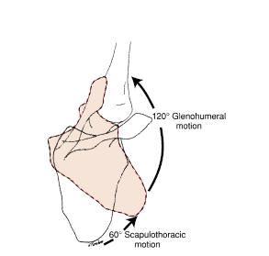

Slide 82
Action of shoulder muscles
Elevation
Glenohumeral joint muscles
Deltoid –
effective deltoid activity depends on intact rotator cuff muscles.
superior translation offset by rot cuff
Assist in abduction after 15⁰ of ROM
Peak activity at 90⁰ humeral abduction
Activity depends upon scapular movt & rot cuff ms

Slide 83
Supraspinatus–GH stabilizer
The supraspinatus muscle is considered an abductor of the humerus.
it functions in all planes of elevation of the humerus.
Coracobrachialis

Slide 84
Scapulothoracic joint muscles
Trapezius – in abduction of arm
The upper trapezius, along with the levator scapula muscle, supports the shoulder girdle against the downward pull of gravity.
2. Serratus anterior – in flexion of arm
The trapezius and lower serratus anterior muscles work synergistically to produce upward rotation of the scapula on the thorax.
Agonist to scapular movt & synergist to GH movt

Slide 85
Force couple-
1st segment – Upper trapezius & upper Serratus Anterior Muscles
2nd segment - Lower Trapezius & lower Serratus Anterior

Slide 86
Rotator cuff muscles
Supraspinatus
Infraspinatus
Teres minor
Subscapularis

Slide 87
B. Controllers of arthrokinematics
Rotator cuff muscles – Horizontal steerers
1. Supraspinatus – compresses the humeral head
2. Infraspinatus & teres minor
Provides external rotation which increases clearance between greater tubercle & acromian
3. Subscapularis, Infraspinatus & Teres Minor centeralize the humeral head

Slide 88
Rhomboids
-stabalizing synergist –scapular rotators,
trapezius ,SA & Teres major
-Paralysis –disruption of scapulohumeral
rhythm
Muscles that adduct & extend the shd
Latismus dorsi, sternocostal head of pect
maj, teres maj, post deltoid, triceps

Slide 89
Internal rotater muscles
Subscapularis,teres major
Latissmus dorsi,pectoralis major
Anterior deltoid
Total ms mass is greater,so produces 1.75 times greater isometric torque than ext rot.
Arthrokinematically,convex humeral head rotates over concave glenoid fossa

Slide 90
External rotater muscles
Infraspinatus, teres minor
Posterior deltoid
Has small % of ms mass at shoulder
So, produces smallest isometric torque of any ms grp at the shoulder.

